Slide 1



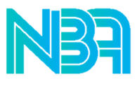
JAWAHARLAL NEHRU TECHNOLOGICAL UNIVERSITY HYDERABAD
UNIVERSITY COLLEGE OF ENGINEERING JAGTIAL (AUTONOMUS)
Nachupally (Kondagattu), Kodimial Mandal, Jagtial Dist,Telangana - 505 501
(Accredited by NAAC A+ & NBA)
Department of CSE
Industrial Oriented Mini Project on
A Blockchain-Based Autonomous Decentralized Online Social Network
Team Members
22JJ1A0539 - E.Krishnaveni 22JJ1A0561 - T.Rishith Kumar
22JJ1A0563 - V.Srujana
22JJ1A0511 - B.Murali Krishna
Project Guide
Dr. B. Sateesh Kumar
Professor & HOD,
Department of CSE

Slide 2

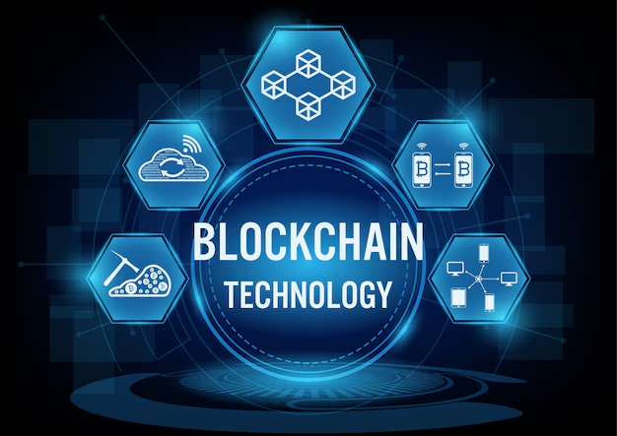

Contents:
1. Abstract
2. Introduction
3. Existing System
4. Proposed System
5. Objectives
6. Architecture
7. Methodologies
8. Output Screens
9. Software requirements
10. Hardware requirements
11. Conclusion

Slide 3
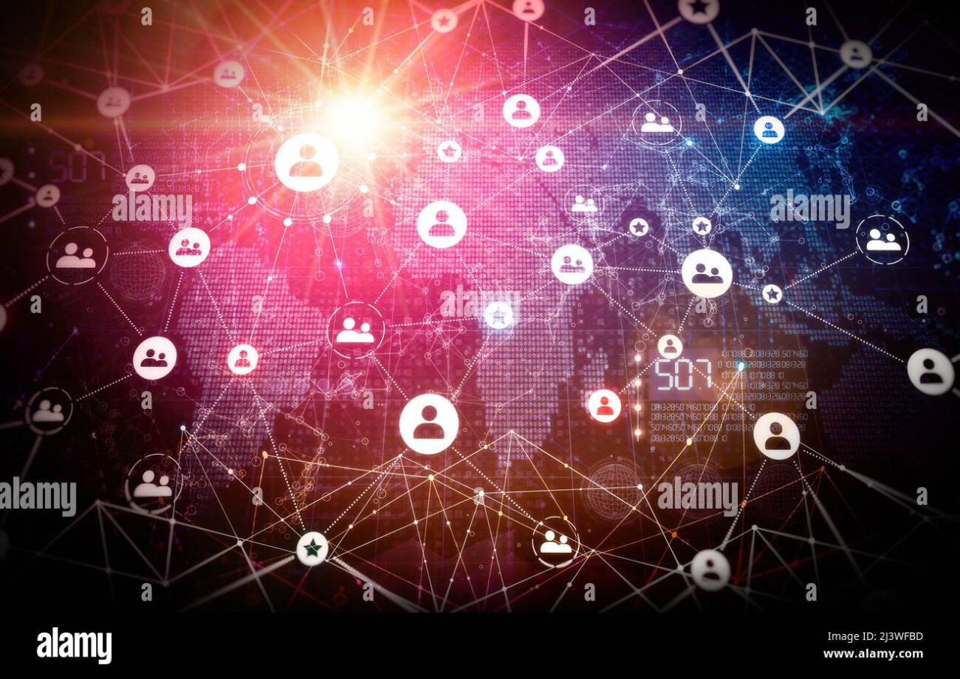
Abstract
Centralized social networking platforms have increasingly raised concerns related to privacy, data ownership, and censorship.
This project proposes a blockchain-based Decentralized Online Social Network (DOSN) to address privacy, data ownership, and censorship concerns. It uses smart contracts to automate publishing and moderation. Decentralized Identity (DID) ensures secure user authentication. IPFS enables distributed media storage. A token economy incentivizes participation and supports community governance in line with Web3 values.

Slide 4

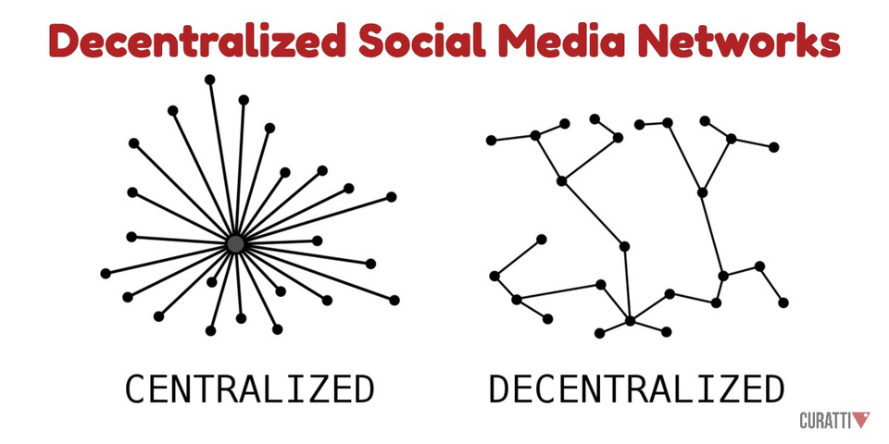
Introduction
Decentralized Social Media Networks
Online Social Networks (OSNs) enable billions to connect, communicate, and build communities globally.
Centralized OSNs control user data and policies, raising concerns about privacy, censorship, and transparency.
Decentralized OSNs aim to return data control to users, enhancing privacy and resisting censorship.
A blockchain-based DOSN using smart contracts, decentralized identities, and IPFS to ensure secure, transparent, and user-governed interaction.

Slide 5




Existing System
Centralized Control:
01
Traditional OSNs like Facebook and Twitter store all user data on centralized servers, giving platforms full authority over data management, content moderation, and monetization.
Privacy and Ownership Issues:
02
Users face privacy risks as their data can be collected and shared without consent, and they lack true ownership of their personal content.
Censorship and Bias:
03
Platforms can arbitrarily censor or suppress content, limiting free expression and transparency.
Vulnerability and Limitations of Decentralized Alternatives:
04
Centralized systems are prone to single points of failure, while existing decentralized networks often struggle with usability, scalability, and effective governance.

Slide 6

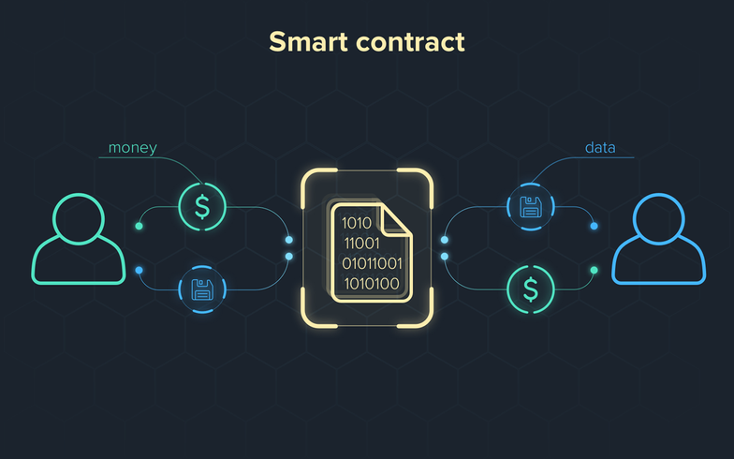
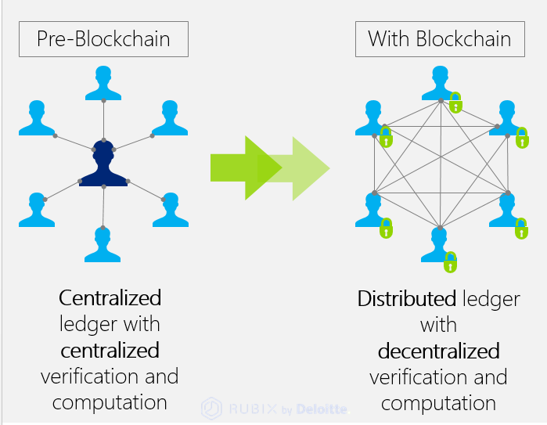
Proposed System
Smart Contracts:
01
Automate essential functionalities such as user registration, content publishing, interactions (likes, comments), and content moderation in a transparent and tamper-proof manner.
Decentralized Identity (DID):
02
Ensures secure and sovereign user identity management, giving users full control over their digital identity.
Distributed Storage (IPFS):
03
Media files and user content are stored in a decentralized way, enhancing data availability and reducing reliance on centralized infrastructure.
Token Economy:
04
A native token system incentivizes active participation, rewards high-quality content, and supports community-led governance through staking and voting mechanisms.

Slide 7

Objectives
Design a decentralized social media platform that operates without central authority using blockchain technology.
Implement smart contracts for automated governance, content moderation, and feature control.
01
02
Ensure user data ownership and privacy through secure, transparent data storage on a distributed ledger.
Enable peer-to-peer communication and community-driven decision-making through token-based voting.
03
04
Design the platform to be censorship-resistant using blockchain's immutability and transparency, ensuring verifiable content and actions.
Ensure platform scalability and user-friendly access to support large user bases without technical barriers.
05
06

Slide 8
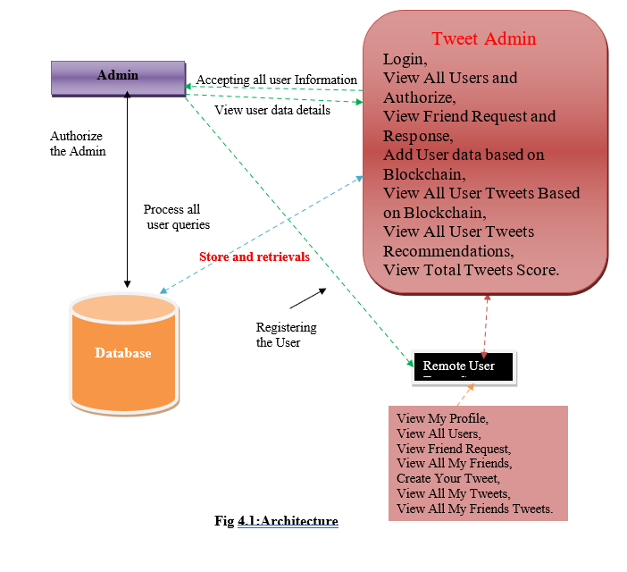
Architecture

Slide 9
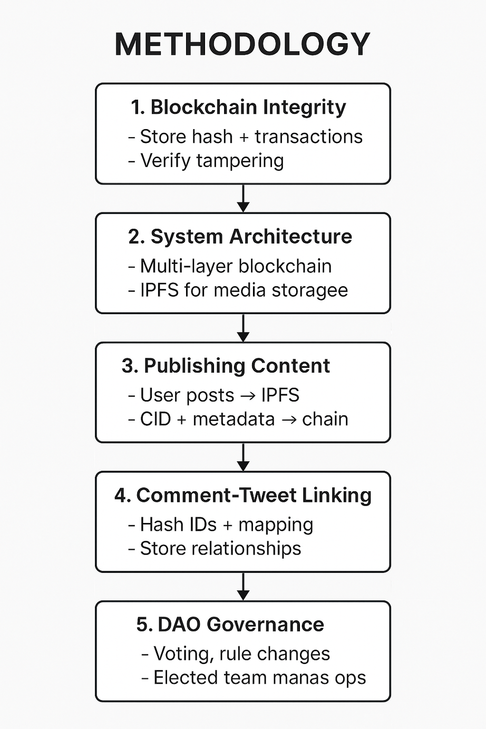
Methodology

Slide 10
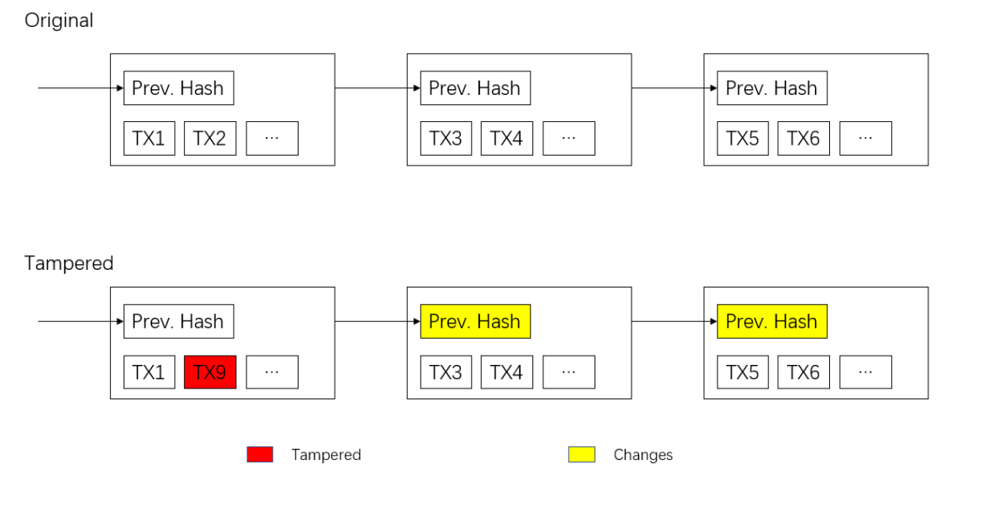
Methodology
1. Blockchain Integrity Verification
Each block contains previous hash and a set of transactions (tweets, comments, etc.).
Ensures tamper-proof data through hash linking.
If any data is altered, all subsequent block hashes are affected—immediately detecting tampering.
Ensures data transparency, authenticity, and immutability in the network.

Slide 11
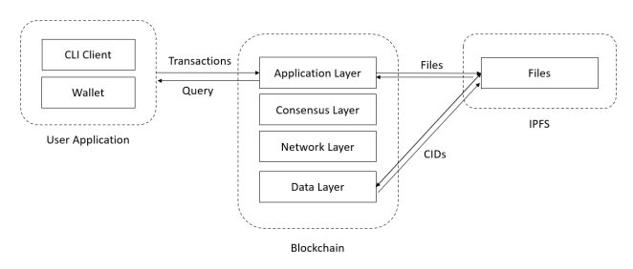
Methodology
2. System Architecture Design
Develop the system using a multi-layer blockchain architecture:
Application Layer: Handles transactions (tweets/comments) and user interfaces
Consensus Layer: Ensures decentralized agreement on new blocks
Network Layer: Manages peer communication
Data Layer: Stores transaction records
Integrate IPFS (InterPlanetary File System) to store media or content off-chain
Store CIDs (Content Identifiers) of IPFS files within blockchain transactions

Slide 12
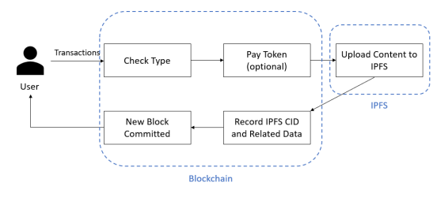
Methodology
3. Publishing Content
A user interaction flow:
User initiates a transaction (e.g., post a tweet)
System checks content type
User optionally pays a token fee
Content is uploaded to IPFS
CID and metadata are recorded on the blockchain
A new block is committed

Slide 13
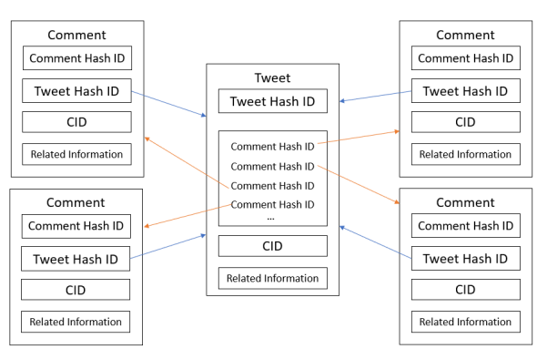
Methodology
4. Comment-Tweet Linking Mechanism
Structure every tweet and comment with unique hash IDs
Establish bidirectional mapping:
Comments point to parent tweet via Tweet Hash ID
Tweet contains list of associated Comment Hash IDs
Store both CID and metadata for integrity and retrievability

Slide 14
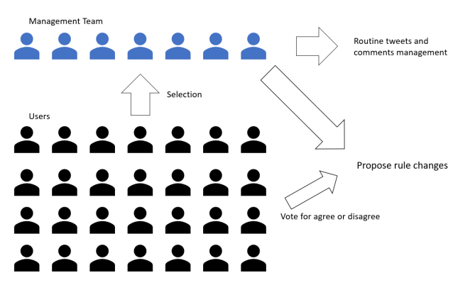
Methodology
5. DAO Governance Structure
Use a Decentralized Autonomous Organization (DAO) to manage platform policies
Users vote on rule proposals (e.g., spam filters, content moderation)
Management team is selected democratically
DAO is responsible for:
Managing tweet/comment operations
Implementing voted rule changes

Slide 15
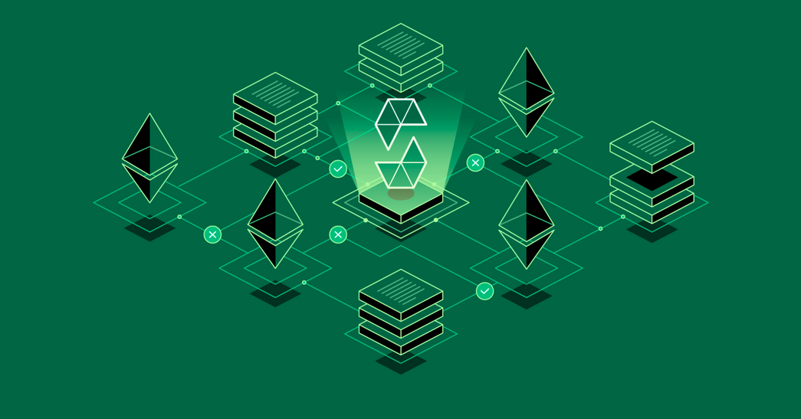
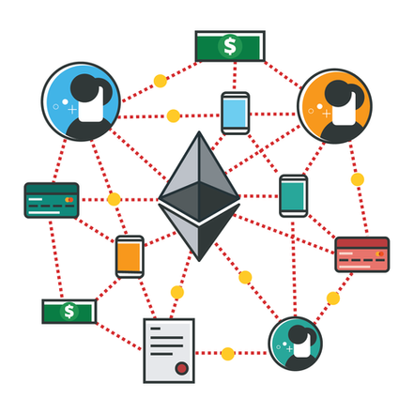

Tech Stack Overview
Blockchain Platform: Ethereum
Smart Contracts: Solidity
Decentralized Identity (DID): uPort
Distributed Storage: Interplanetary File System
Front-End: React.js / Next.js with Web3.js / Ethers.js
Backend: Node.js
Database: MySQL

Slide 16
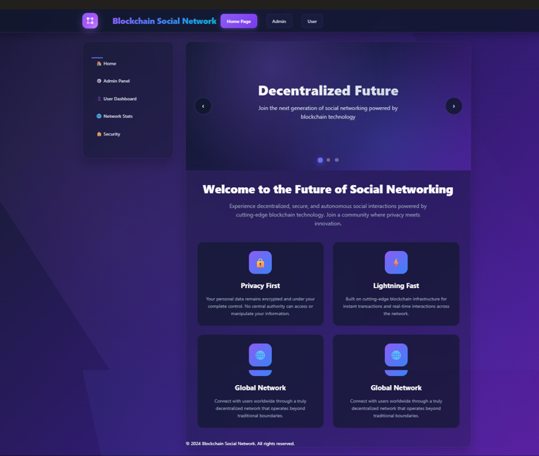
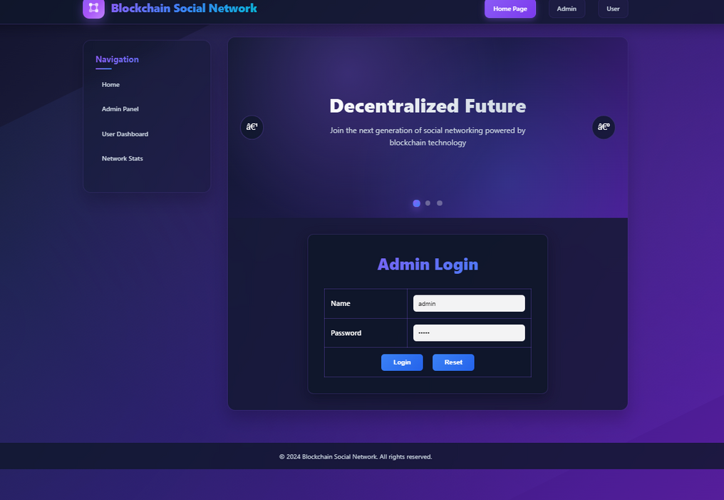
Output Screens
Home Page
Admin Login

Slide 17
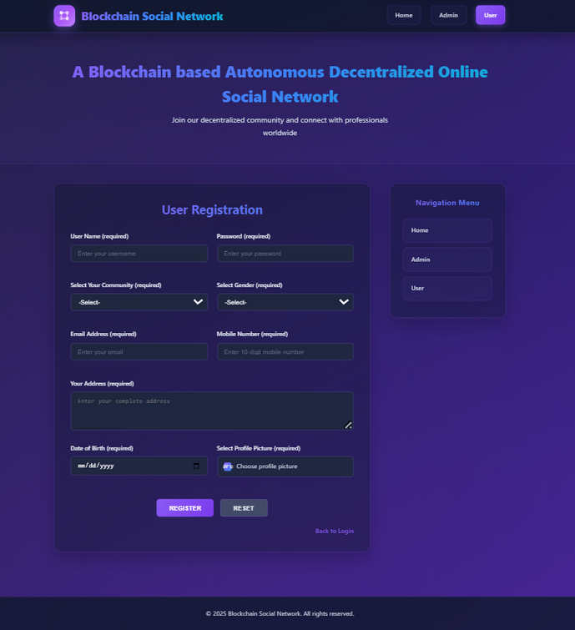
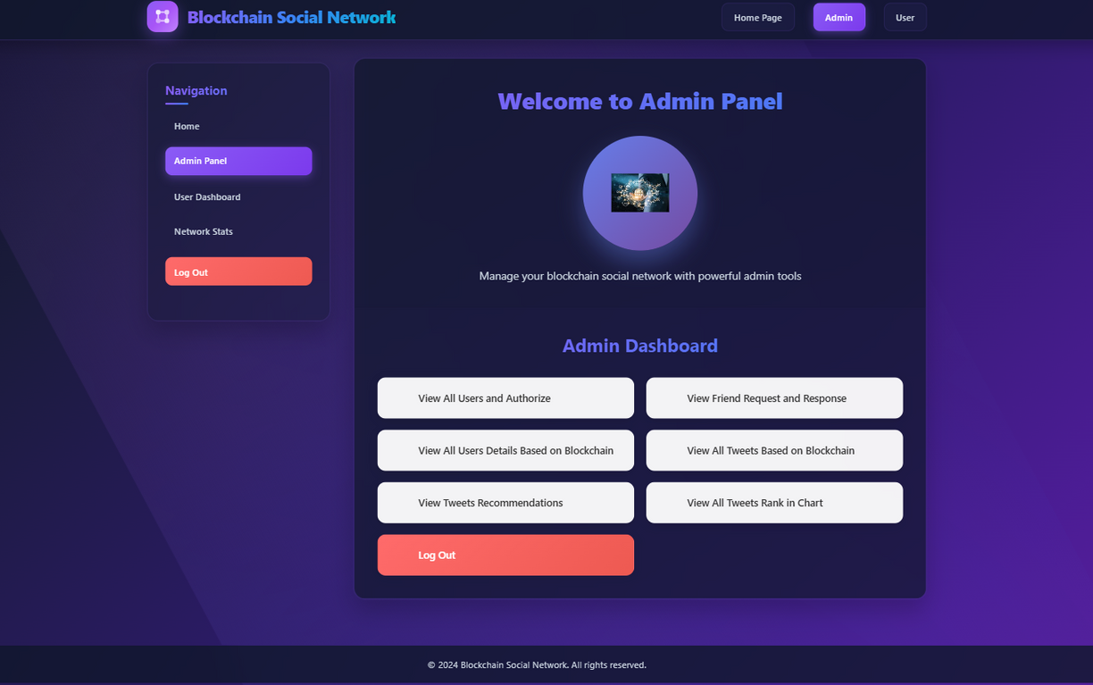
Output Screens
Admin Dashboard
User Registration

Slide 18
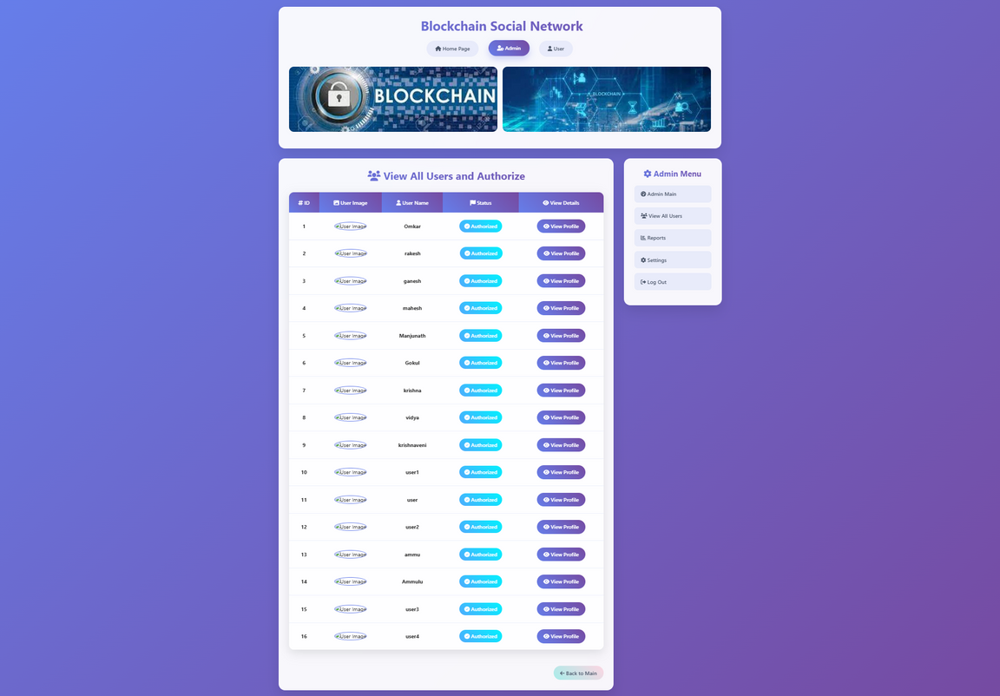
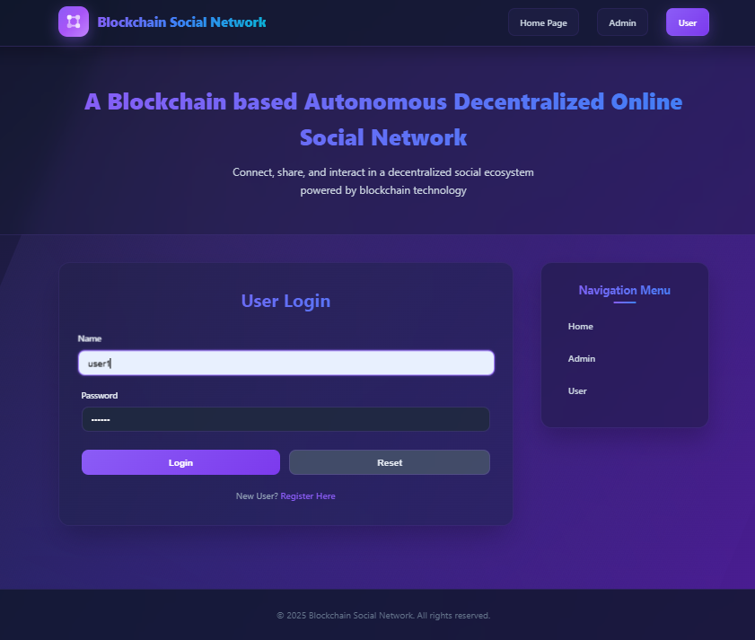
Output Screens
View all users and authorise
User Login

Slide 19
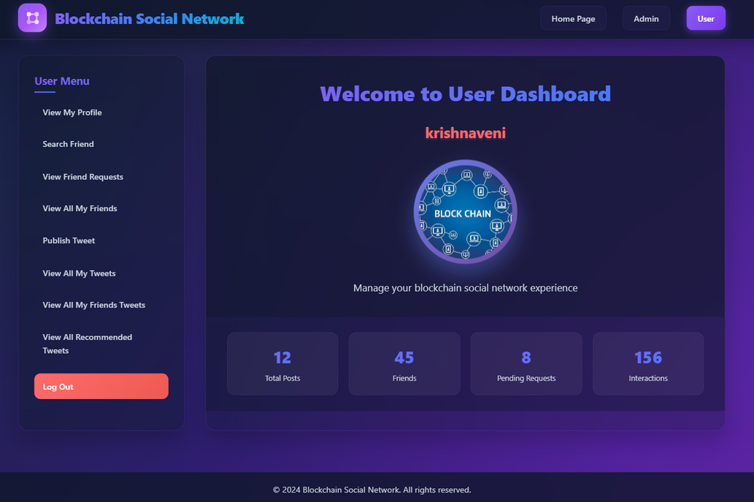
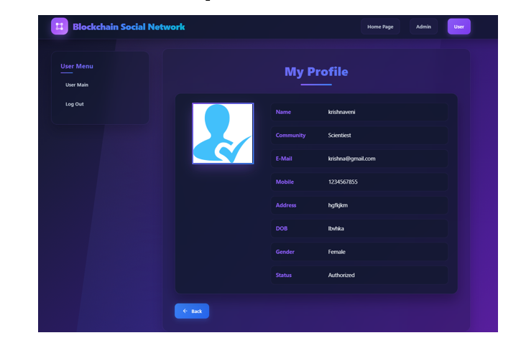
Output Screens
User Dashboard
User Profile

Slide 20
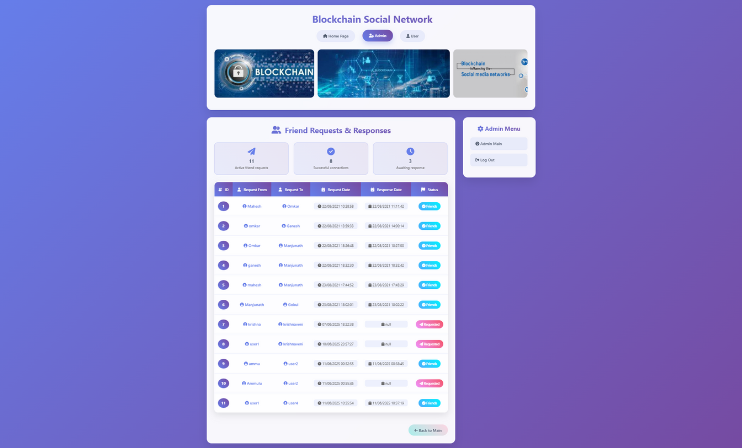
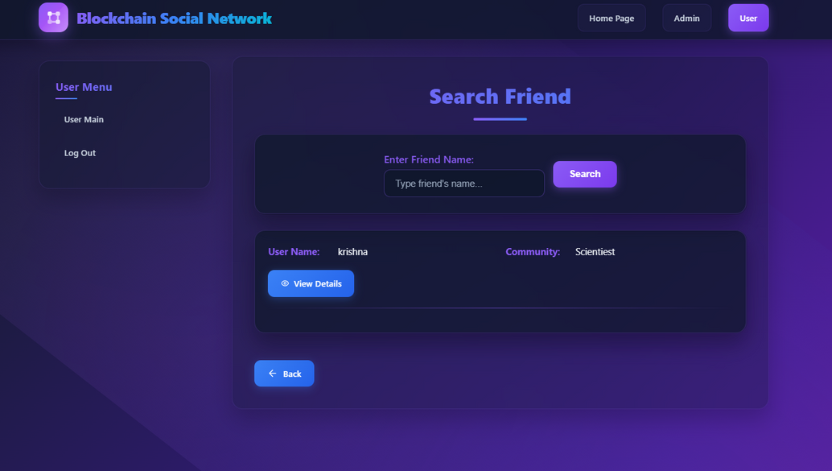
Output Screens
Searching Friend
View all request & responses

Slide 21
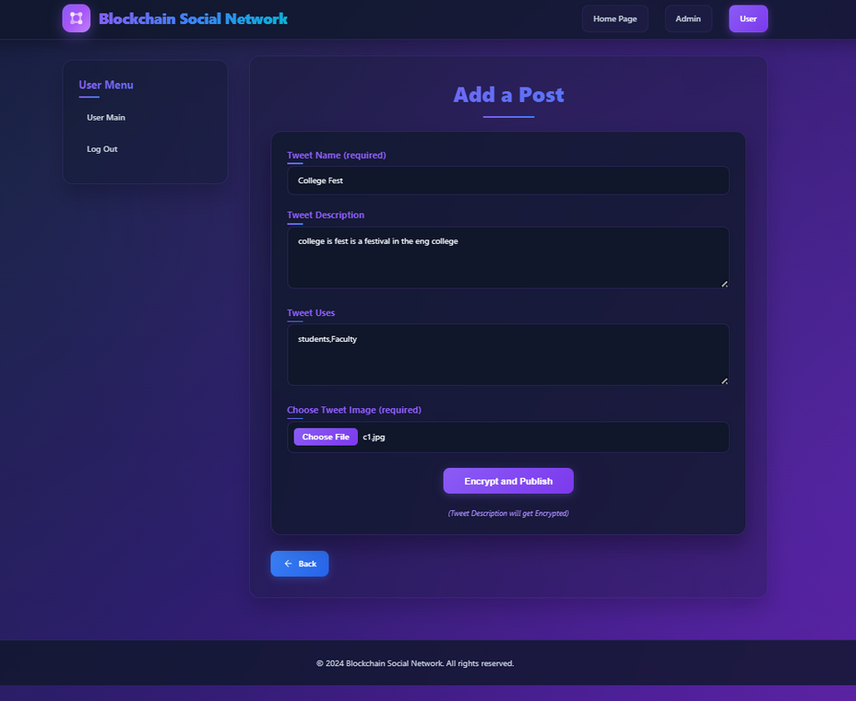
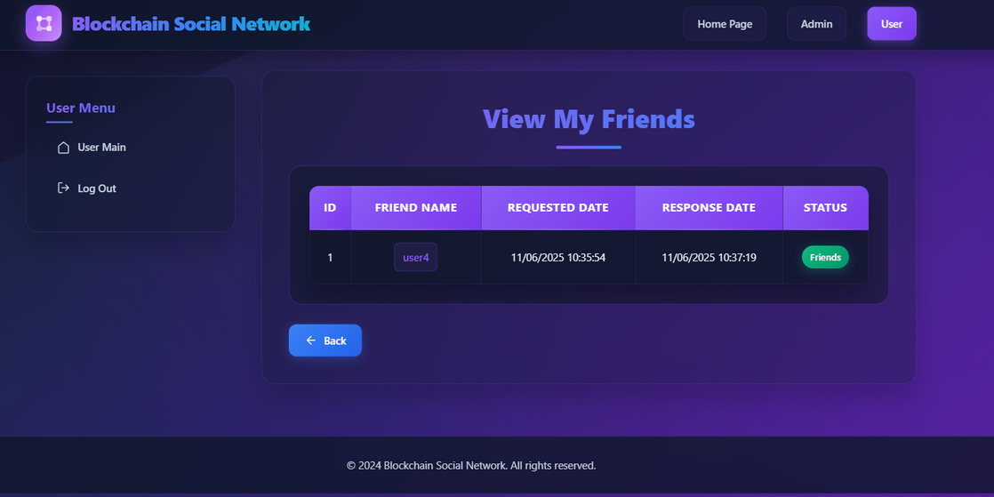
Output Screens
View all my friends
Add a tweet

Slide 22
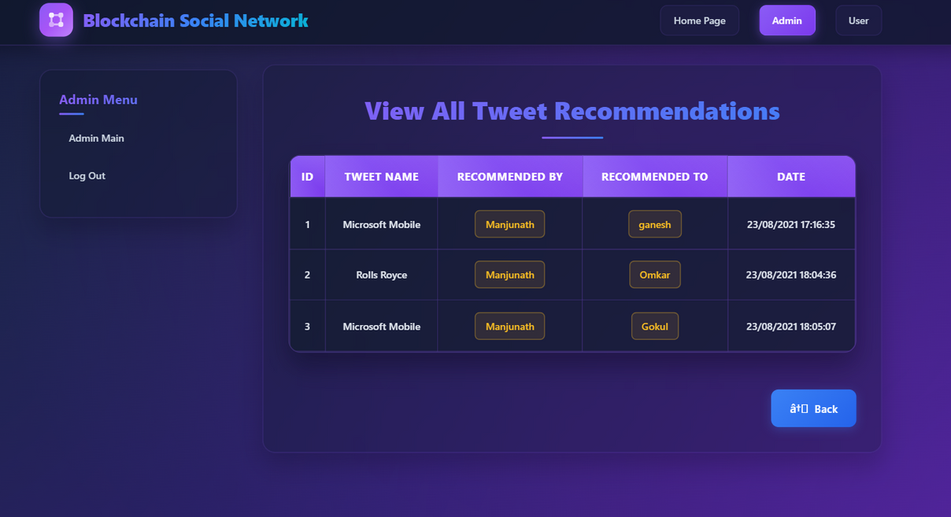
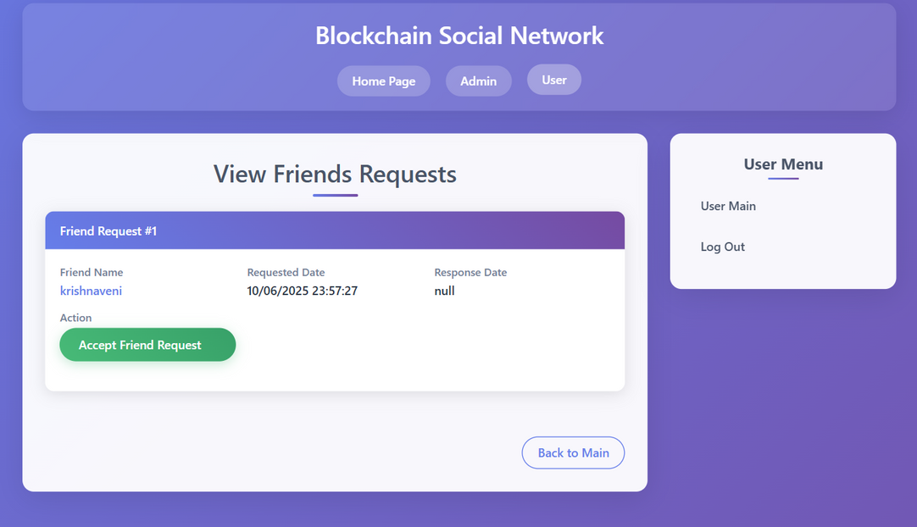
Output Screens
View all my recommended tweets
View all tweet recommendations

Slide 23
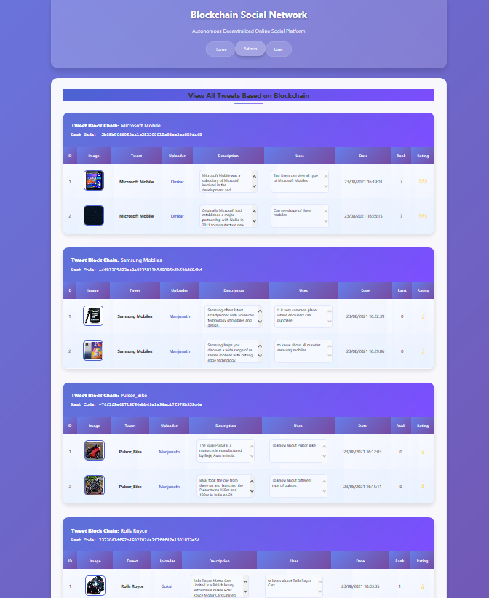
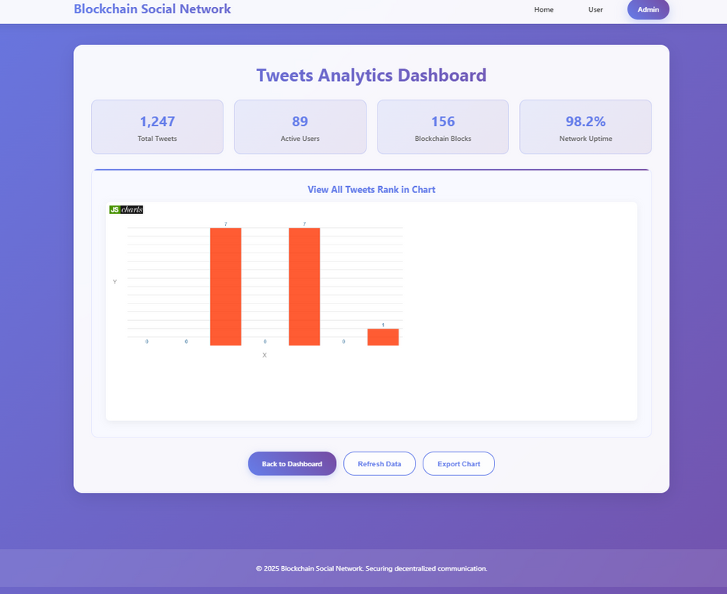
Output Screens
View all tweets based on Blockchain
View all tweets rank in chart

Slide 24
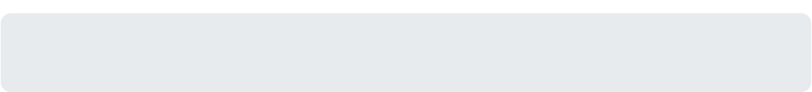

Software Requirements
OS: Windows 10 or 11
IDE / Code Editor: VS Code
Browser: Google Chrome / Firefox
Version Control: Git
Database Tool: MySQL Workbench

Slide 25
Hardware Requirements
Processor: Intel i3 or higher
RAM: Minimum 4 GB
Storage: At least 40 GB HDD/SSD
System Type: 64-bit operating system

Slide 26

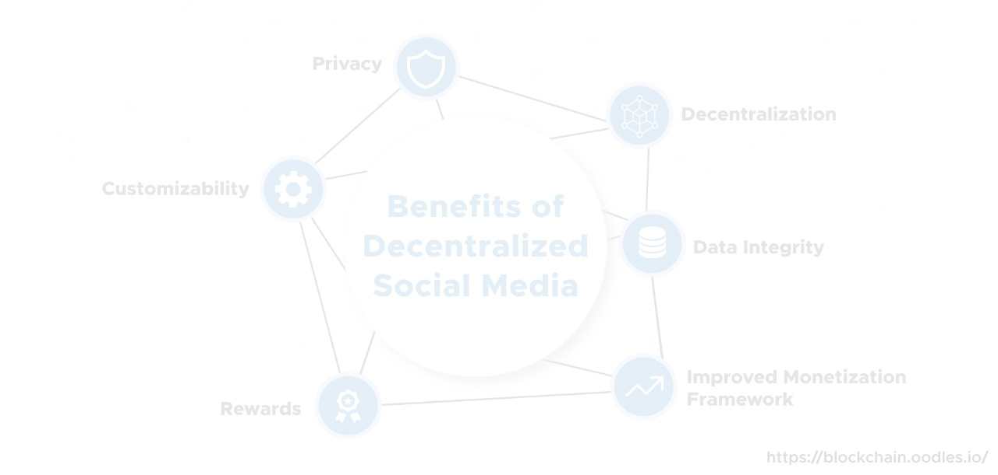


Conclusion
This project redefines social networking by shifting control from centralized entities to users themselves.
With blockchain, smart contracts, and decentralized storage, it ensures privacy, ownership, and transparency.
Users enjoy full control over their data, content freedom, and token-based incentives.
Community governance replaces corporate oversight, setting the stage for the future of social interaction.

Slide 27

Thank You
Any Queries??

